Slide 1
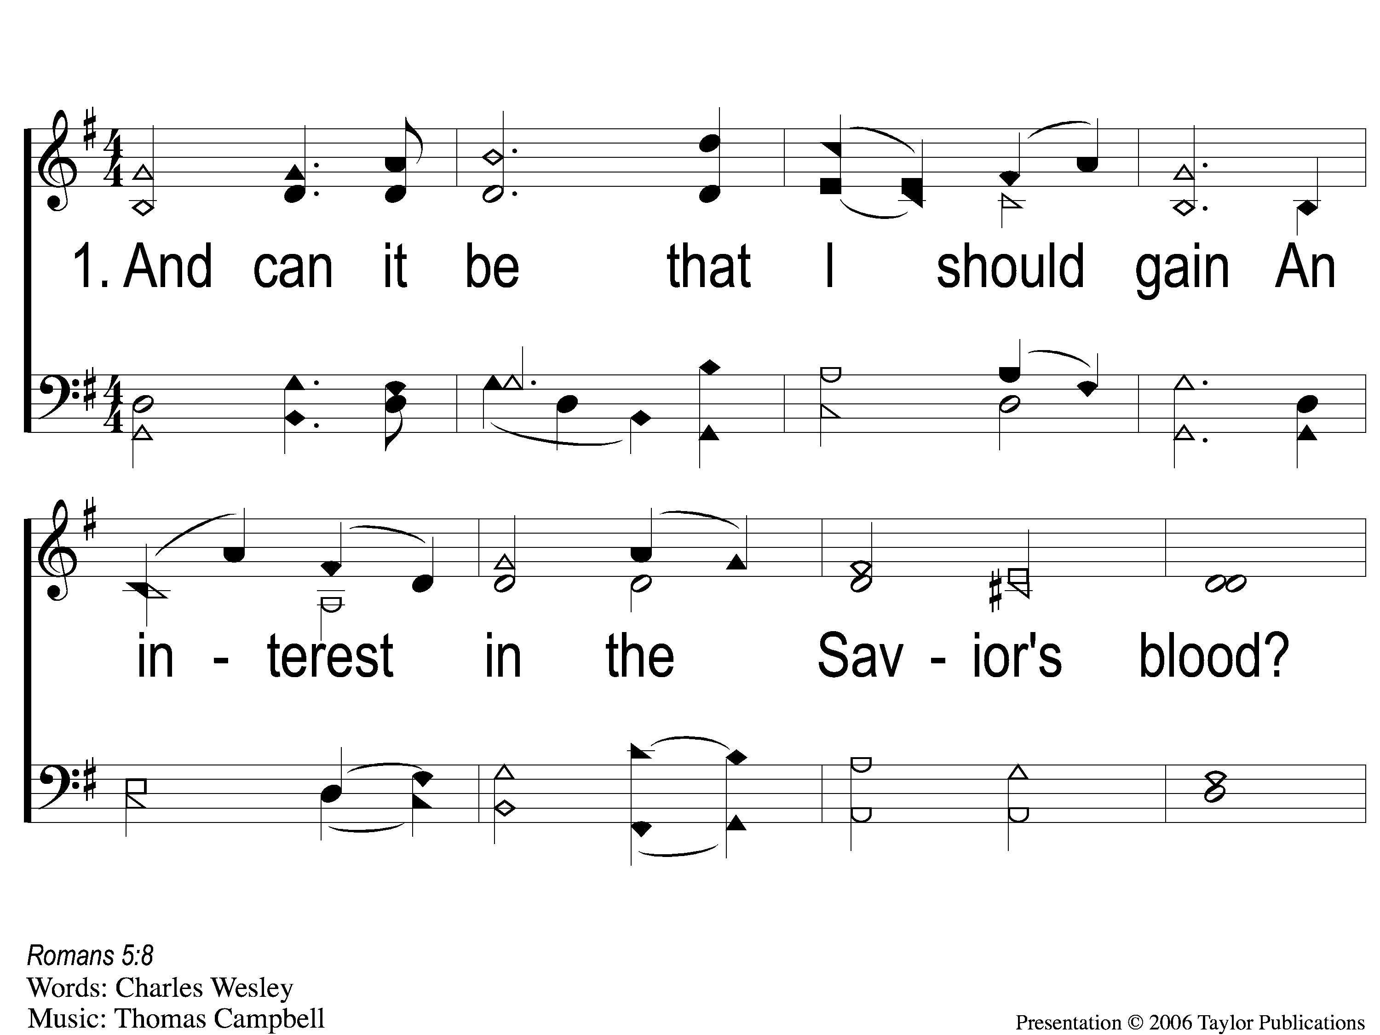
1-1 And Can It Be
And Can It Be
371

Slide 2
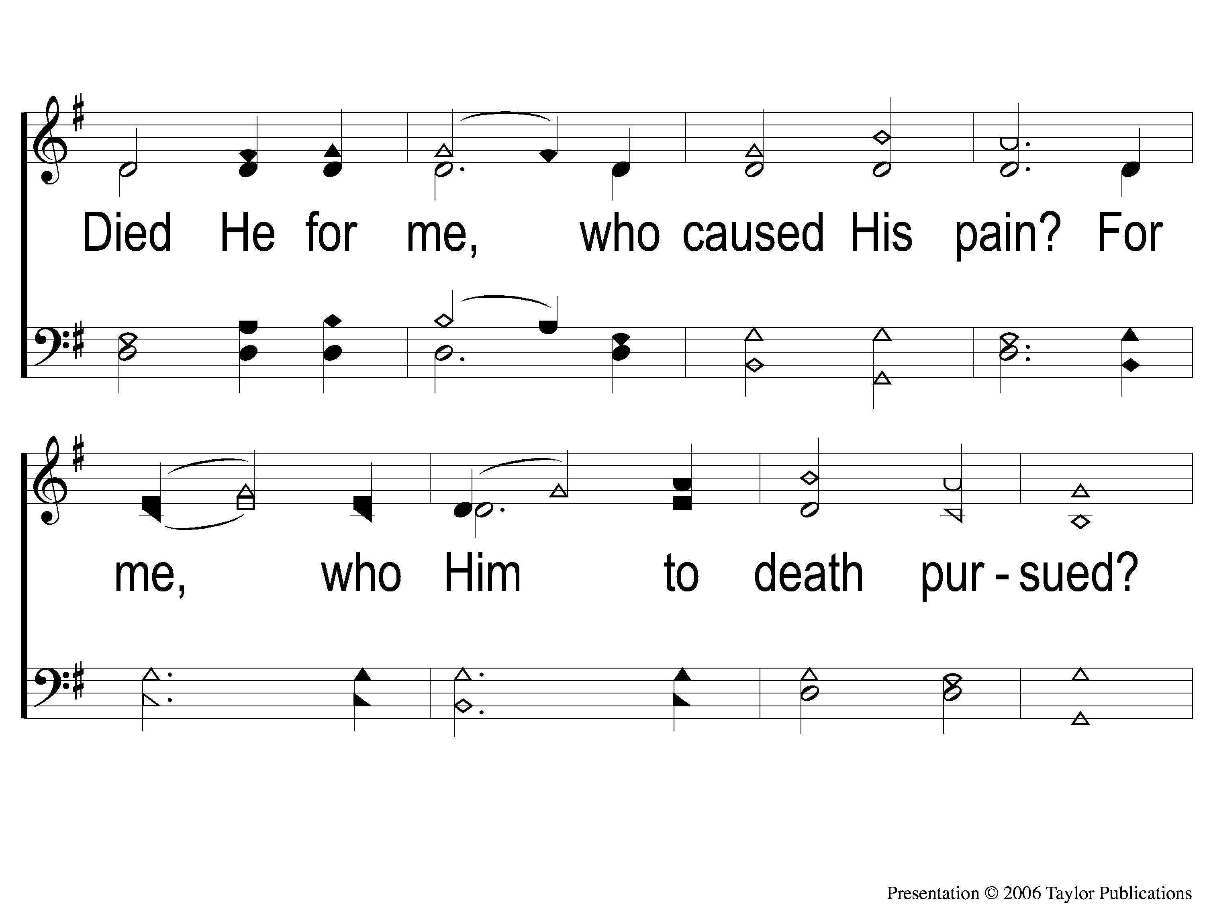
1-2 And Can It Be
And Can It Be
371

Slide 3
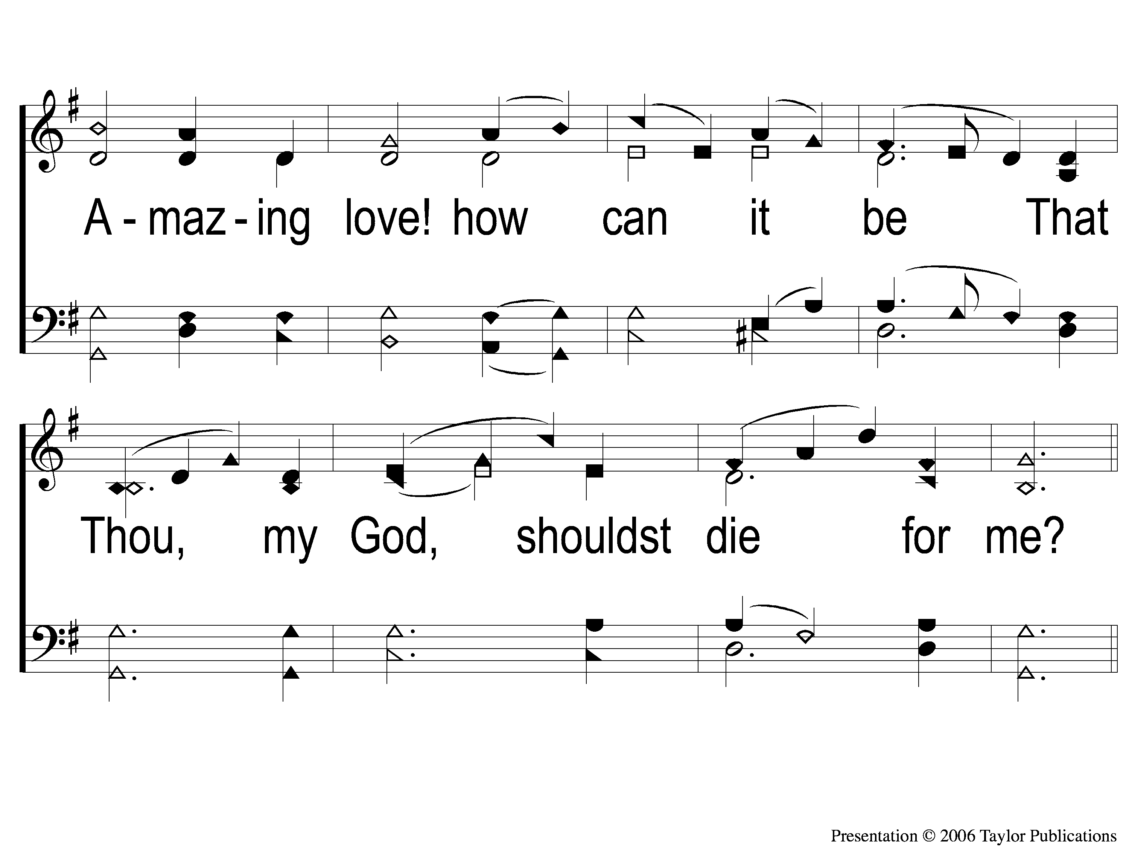
1-3 And Can It Be
And Can It Be
371

Slide 4
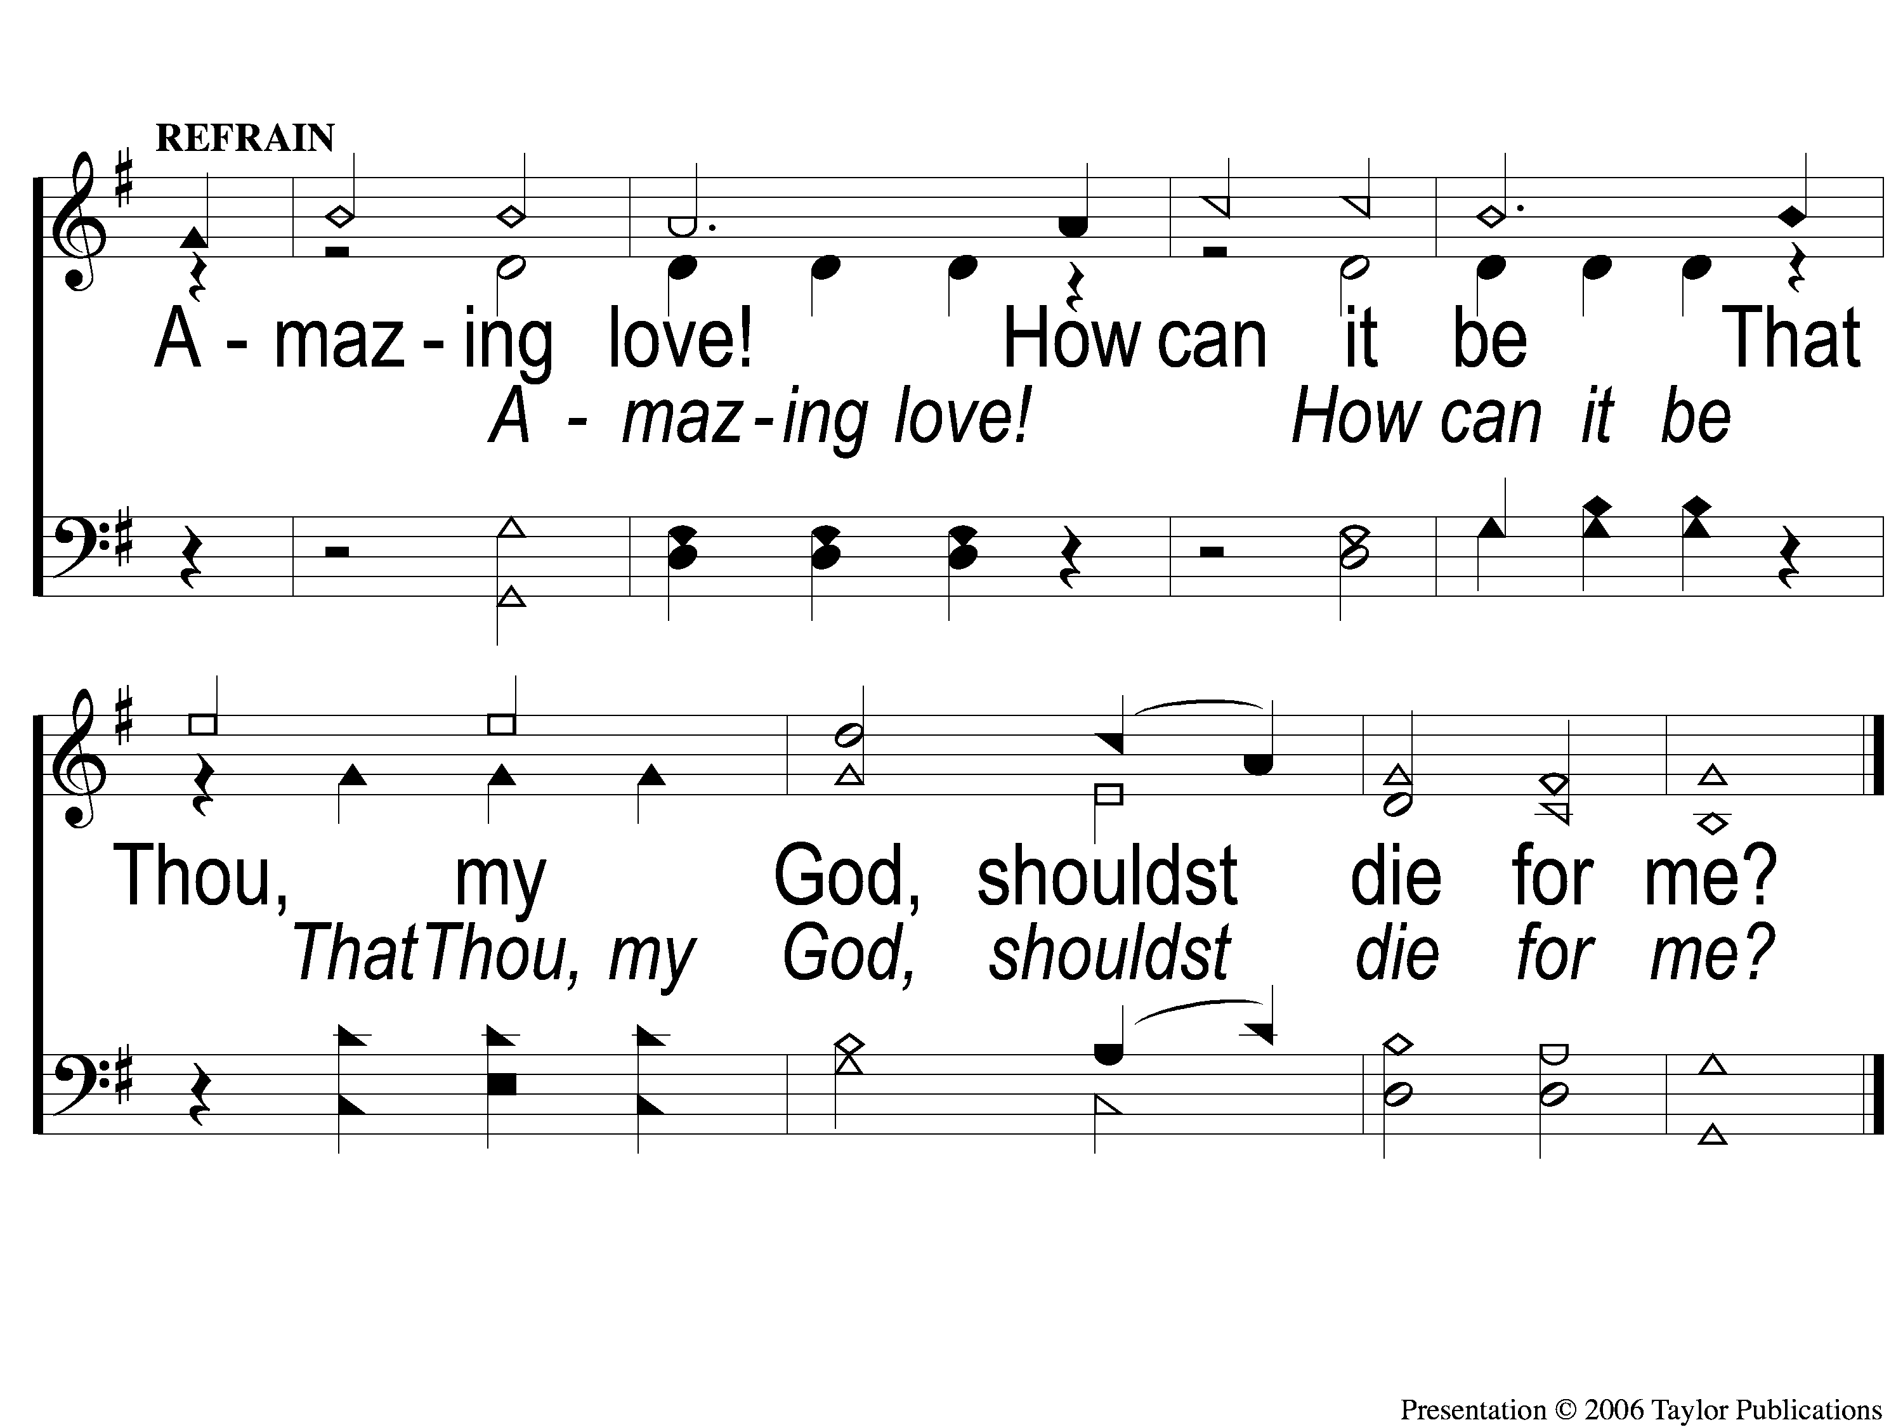
C And Can It Be
And Can It Be
371

Slide 5
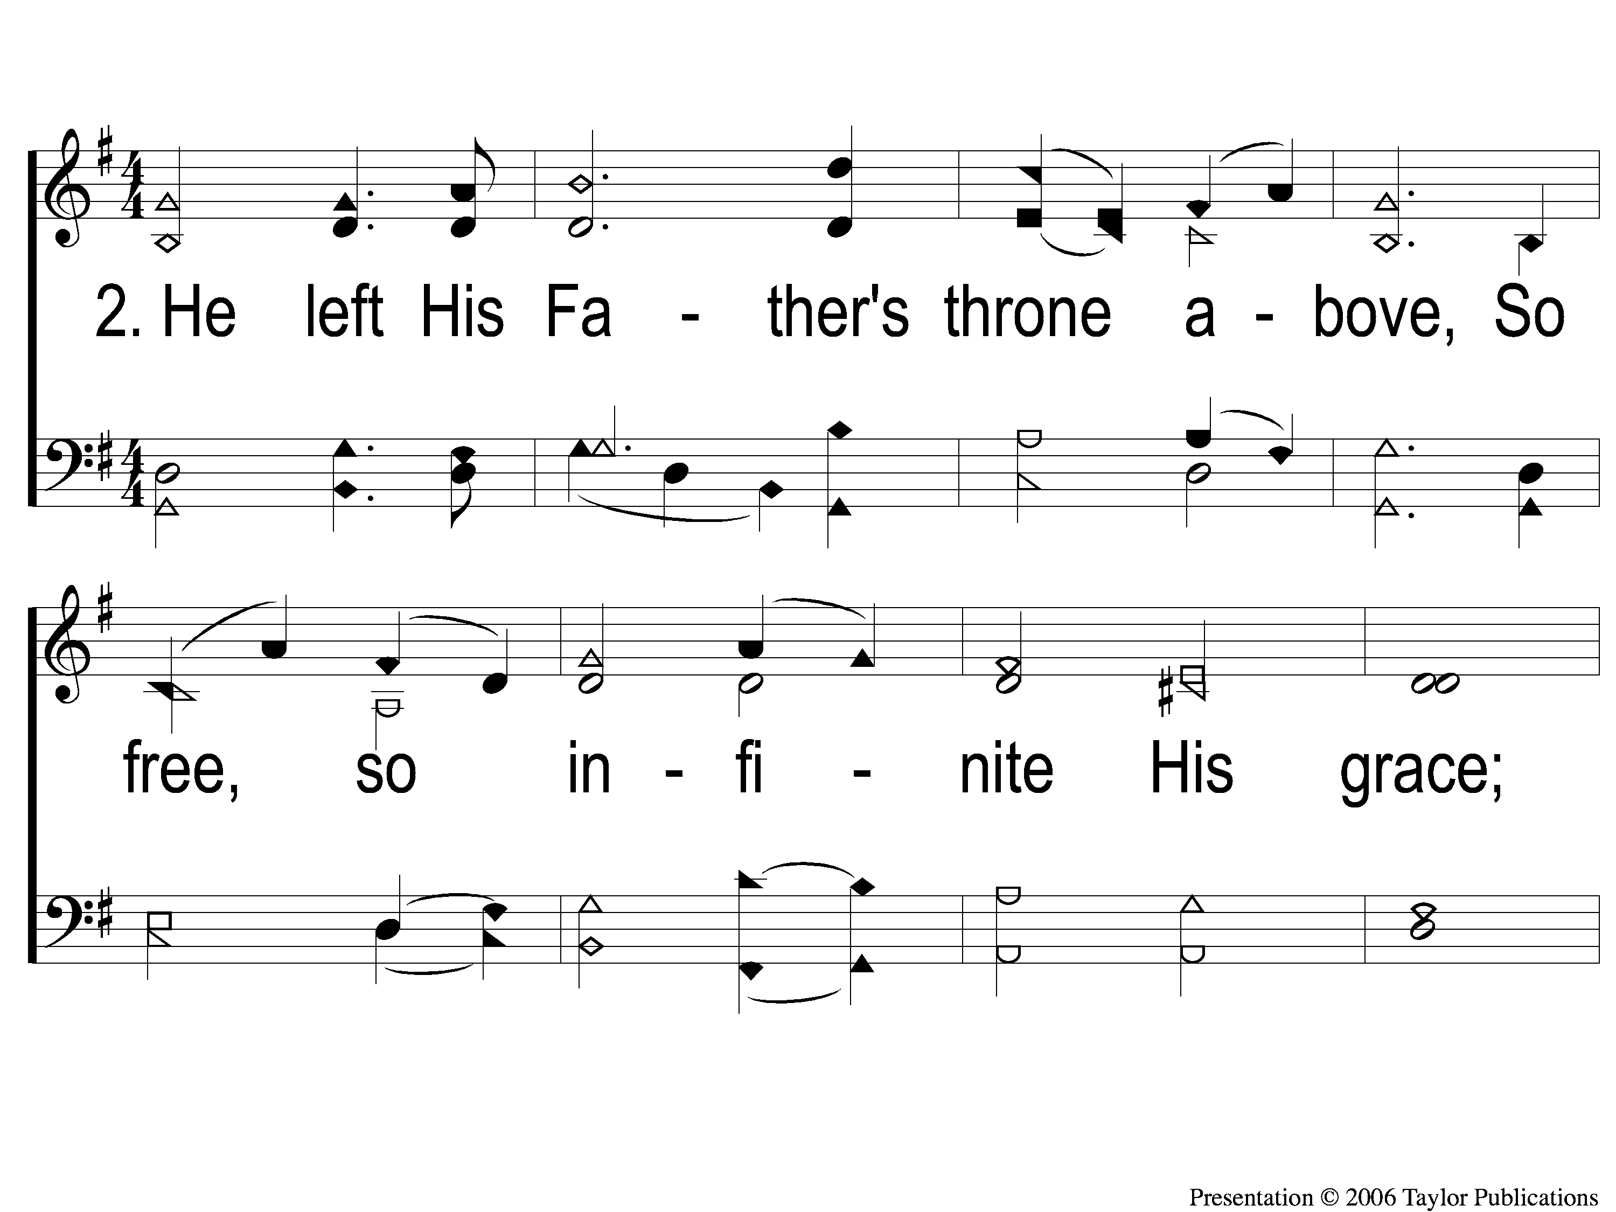
2-1 And Can It Be
And Can It Be
371

Slide 6
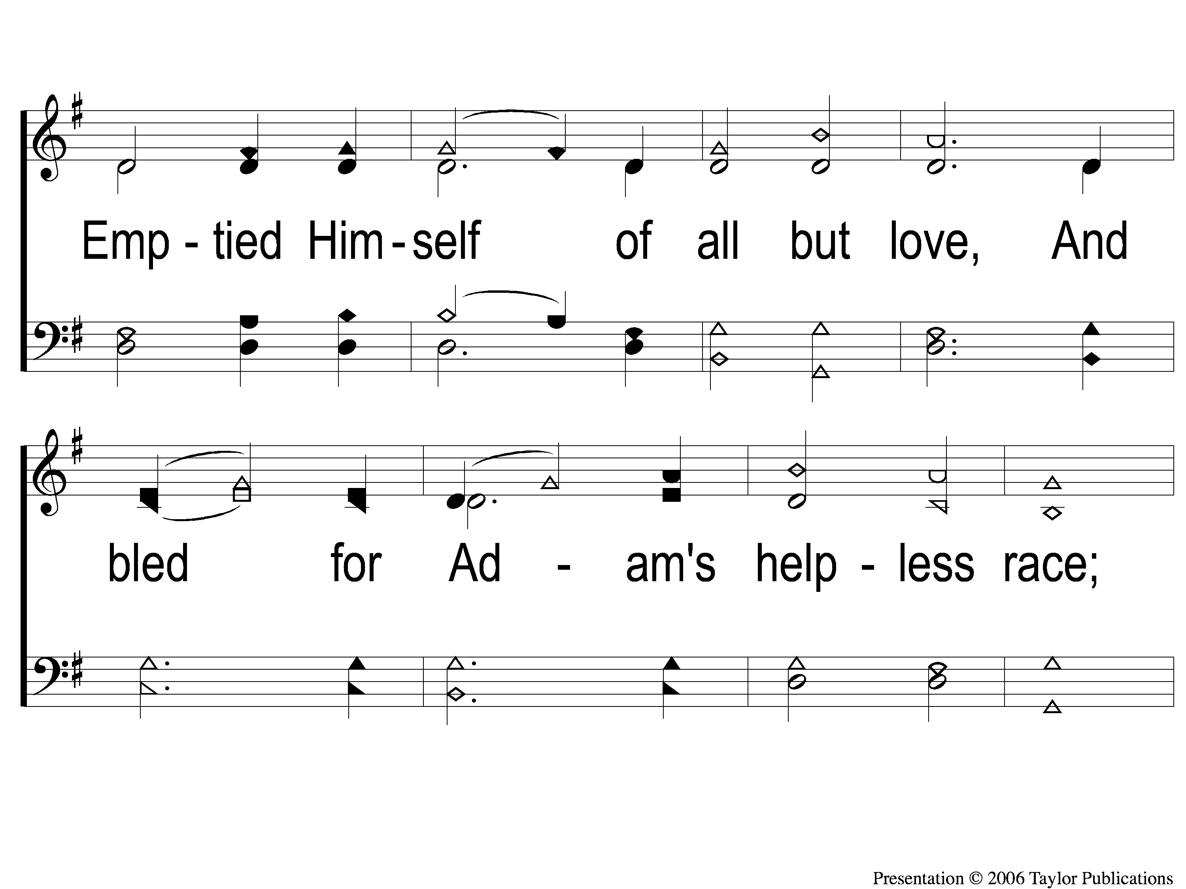
2-2 And Can It Be
And Can It Be
371

Slide 7
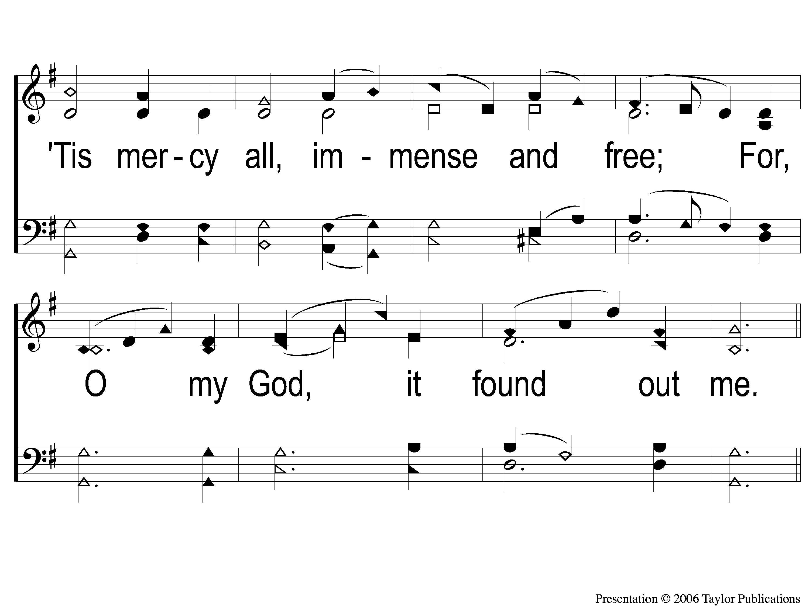
2-3 And Can It Be
And Can It Be
371

Slide 8
C And Can It Be
And Can It Be
371

Slide 9
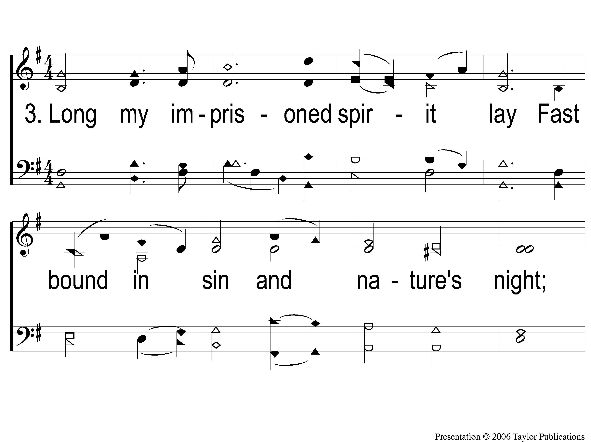
3-1 And Can It Be
And Can It Be
371

Slide 10
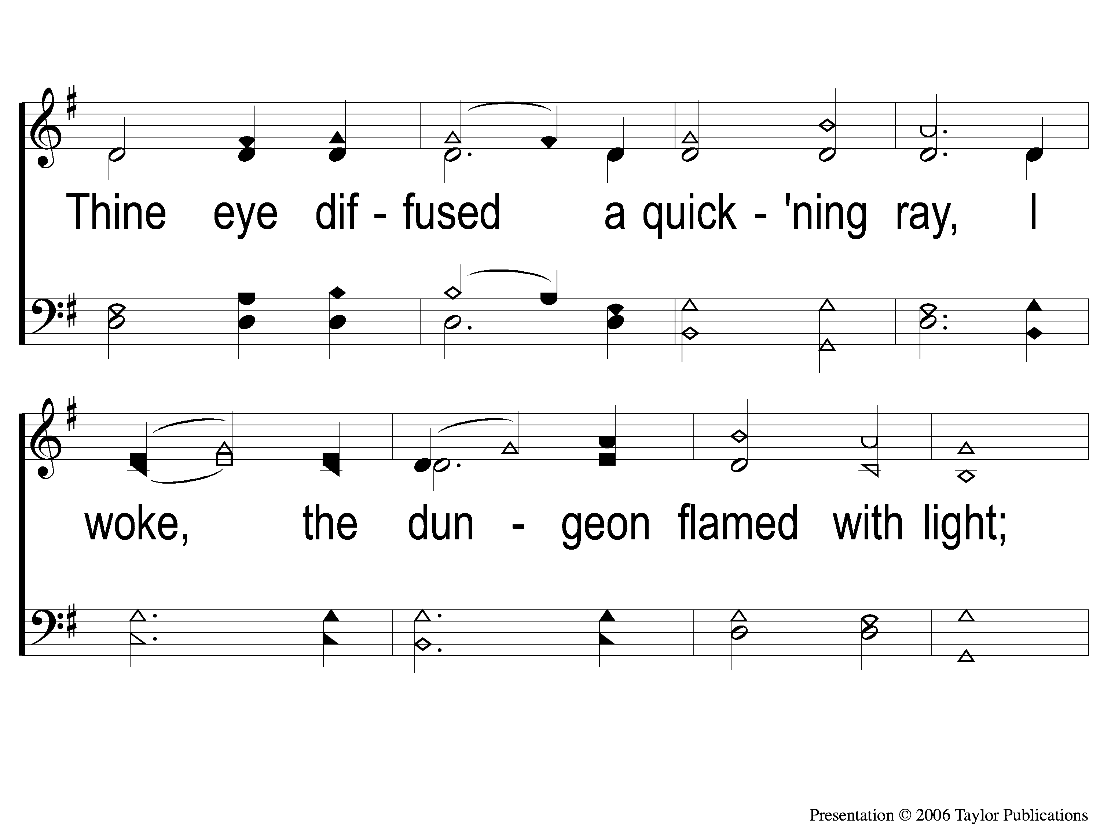
3-2 And Can It Be
And Can It Be
371

Slide 11
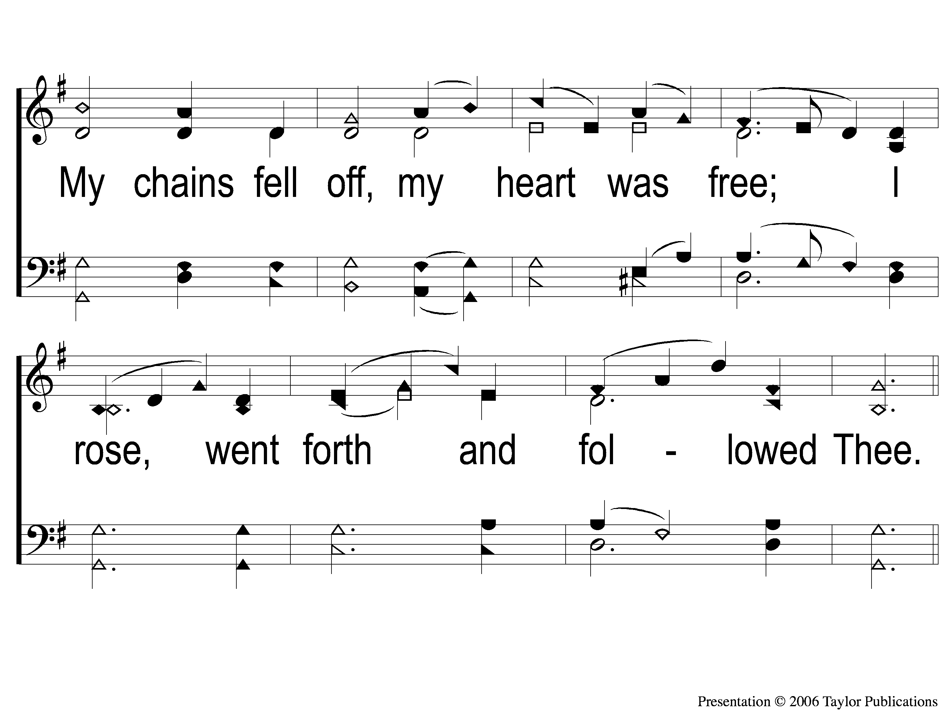
3-3 And Can It Be
And Can It Be
371

Slide 12
C And Can It Be
And Can It Be
371

Slide 13
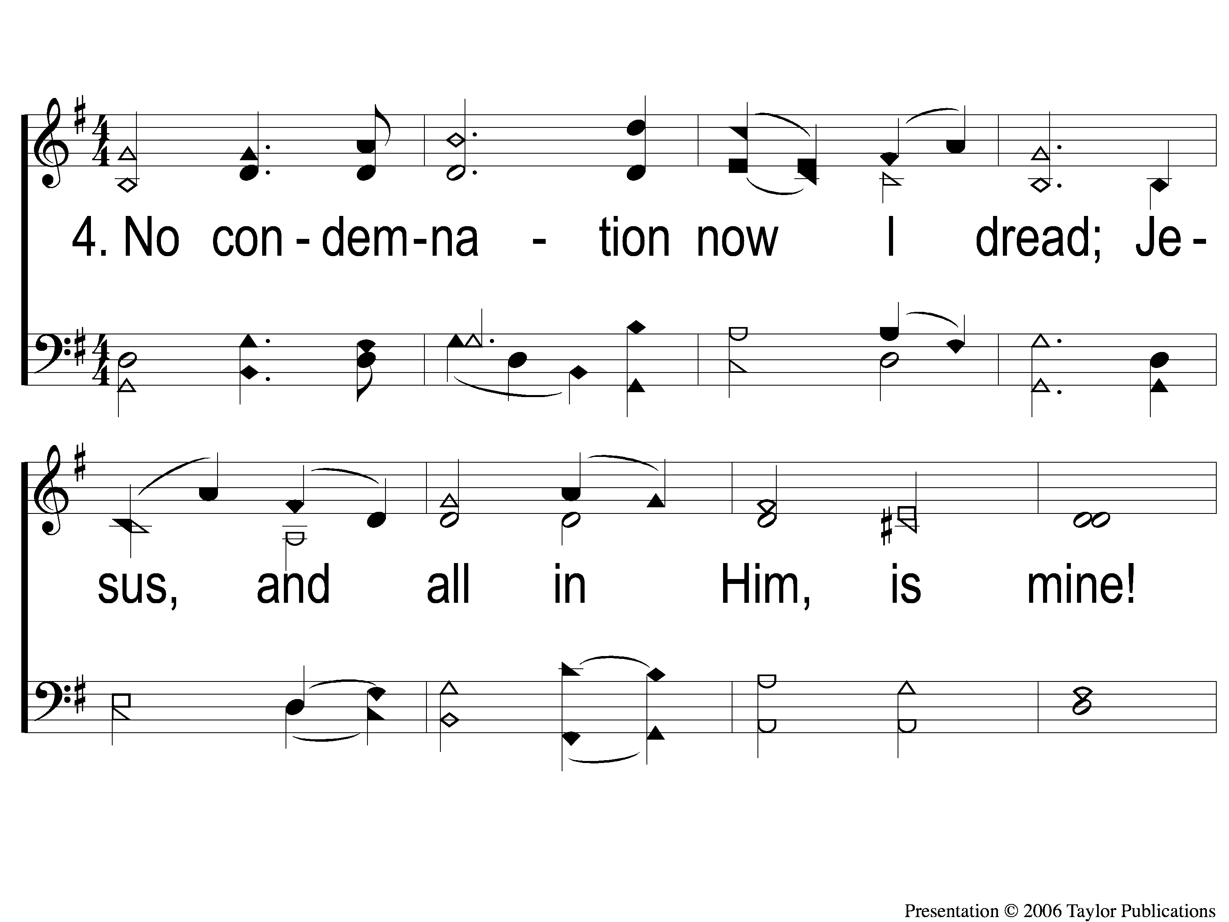
4-1 And Can It Be
And Can It Be
371

Slide 14
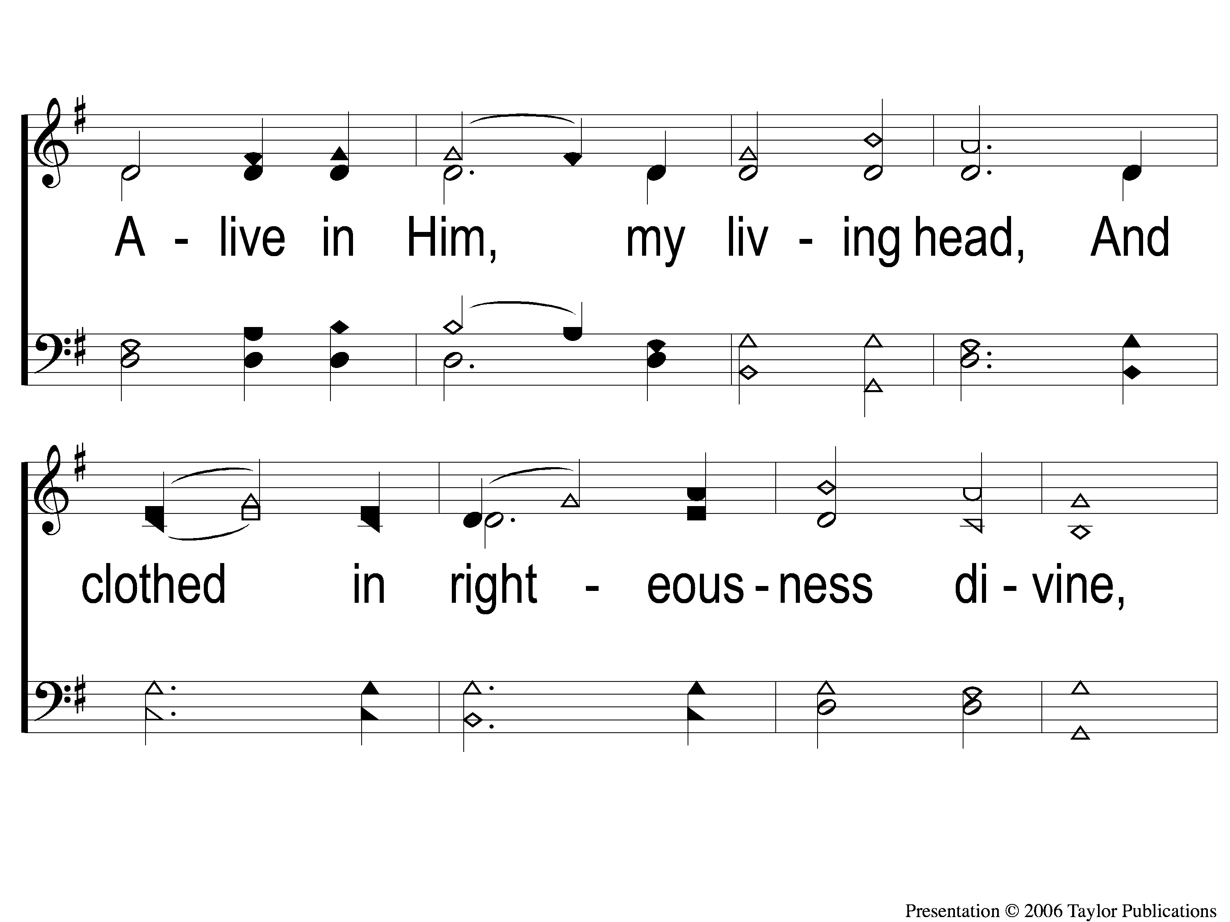
4-2 And Can It Be
And Can It Be
371

Slide 15
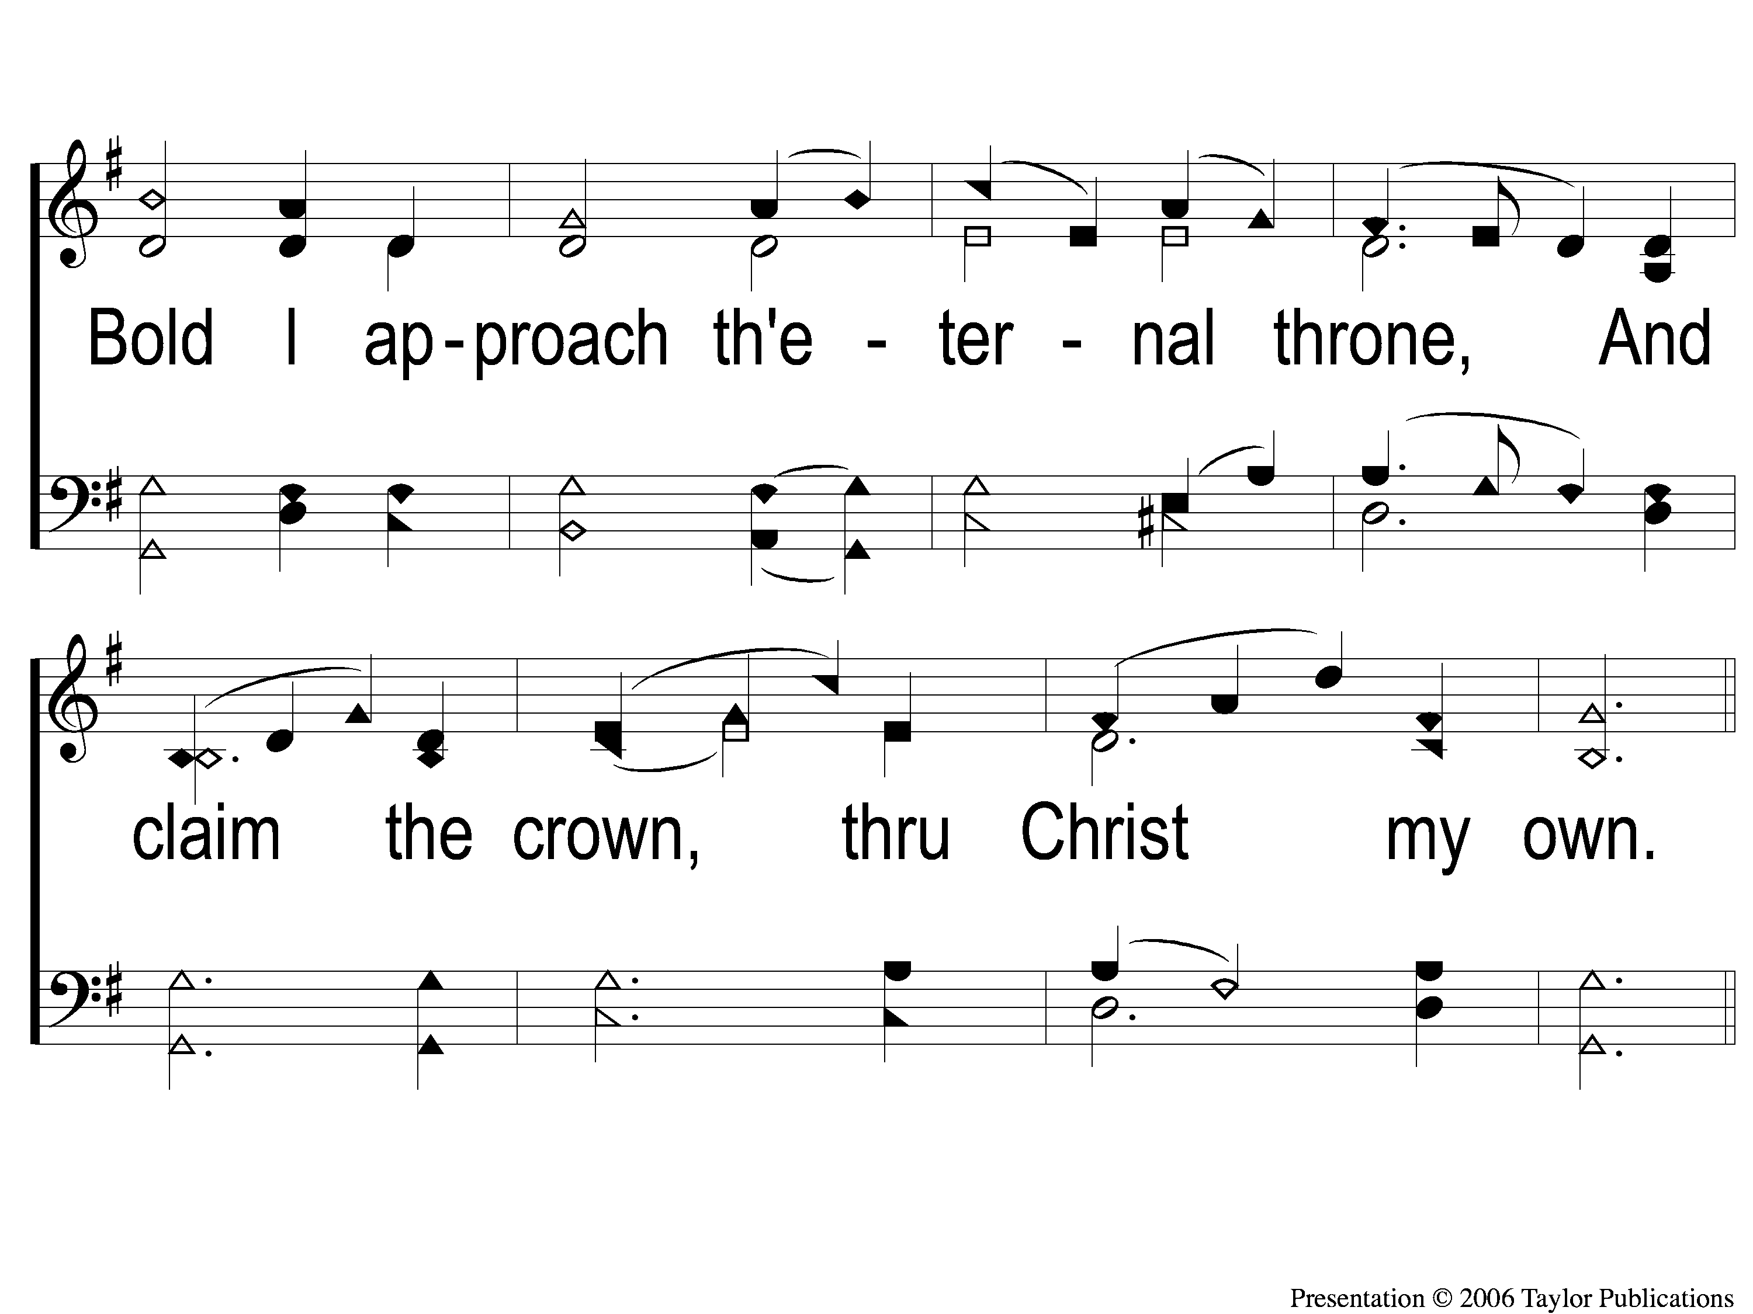
4-3 And Can It Be
And Can It Be
371

Slide 16
C And Can It Be
And Can It Be
371

